Slide 1

Simple queue service

Slide 2
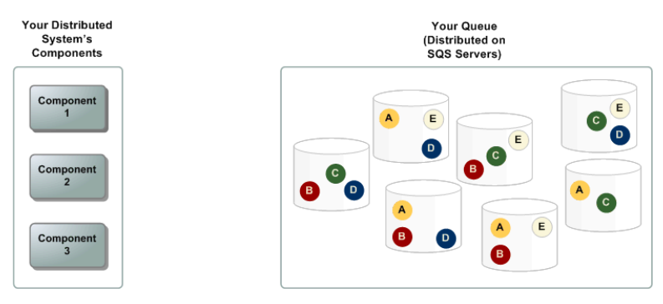
Distributed queues

Slide 3
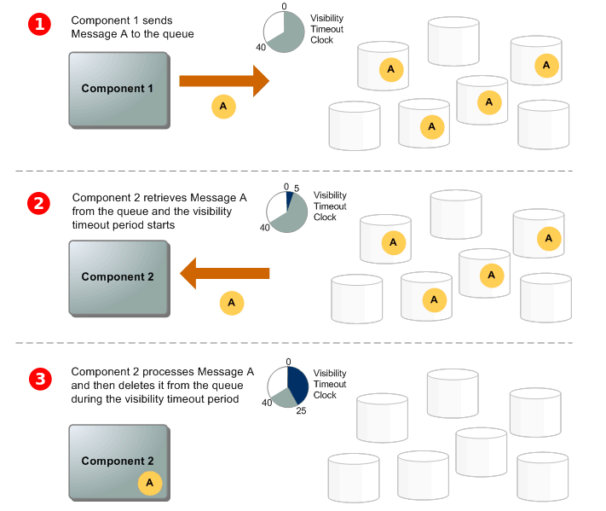
Message lifecycle

Slide 4
Standard queues
Offers
Atleast once delivery
Maintains the best way possible for message ordering
Offers: Send Message, Receive message and Delete message
Use cases:
Decouple live user requests from intensive background work
Allocate tasks to multiple worker nodes
Batch messages for future processing

Slide 5
FIFO queues
Offers
Exactly once processing
The ordering of the processing is always preserved
Use cases:
Ensure that user-entered commands are executed in the right order.
Display the correct product price by sending price modifications in the right order.
Prevent a student from enrolling in a course before registering for an account.

Slide 6
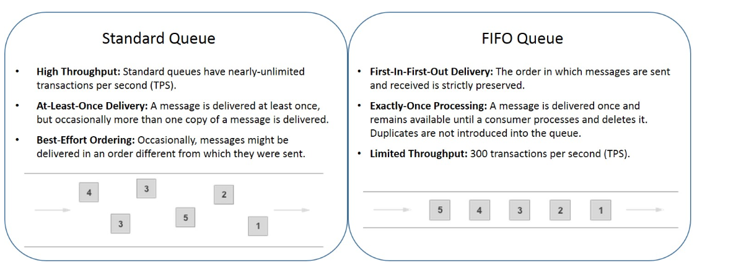
FIFO vs standard queues

Slide 7
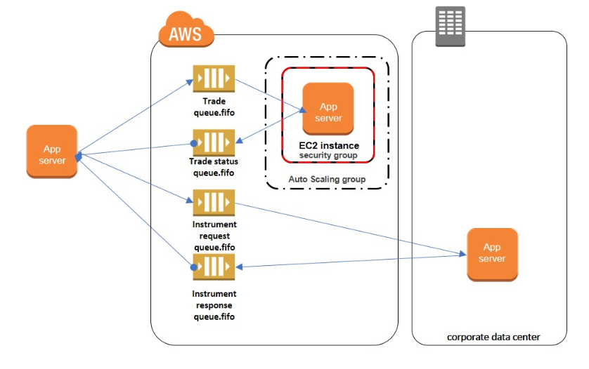
FIFO ORDERING STUFF

Slide 8
Key components of messages
Queue name and URL
System-assigned message ID that Amazon SQS returns to you in the SendMessage response
Message ID
Handle upon receipt of every message
MbZj6wDWli+JvwwJaBV+3dcjk2YW2vA3+STFFljTM8tJJg6HRG6PYSasuWXPJB+Cw Lj1FjgXUv1uSj1gUPAWV66FU/WeR4mq2OKpEGYWbnLmpRCJVAyeMjeU5ZBdtcQ+QE auMZc8ZRv37sIW2iJKq3M9MFx1YvV11A2x/KSbkJ0=
Receipt handle

Slide 9
Message metadata
Message attributes:
Additional information
Upto 10 attributes are possible
Message attribute components
Name
Type
Value

Slide 10
Resource required to process queues
Task | Attribute name
Get the approximate number of messages available for retrieval from the queue. | ApproximateNumberOfMessages
Get the approximate number of messages in the queue that are delayed and not available for reading immediately. This can happen when the queue is configured as a delay queue or when a message has been sent with a delay parameter. | ApproximateNumberOfMessagesDelayed
Get the approximate number of messages that are in flight. Messages are considered to be in flight if they have been sent to a client but have not yet been deleted or have not yet reached the end of their visibility window. | ApproximateNumberOfMessagesNotVisible

Slide 11
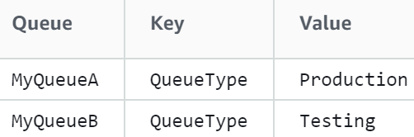
Tagging of queues
Recommended to tag your queues:
To manage cost
Get easy visibility of queues

Slide 12
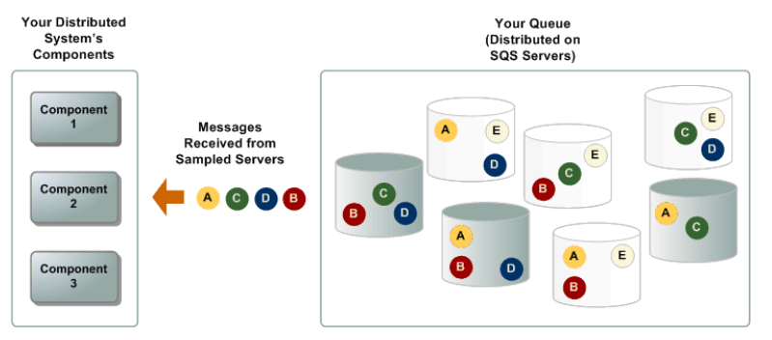
Long and short polling
Attributes for the short polling:
For super quick response use short polling.
Not a very accurate response
Subset of the servers are checked

Slide 13
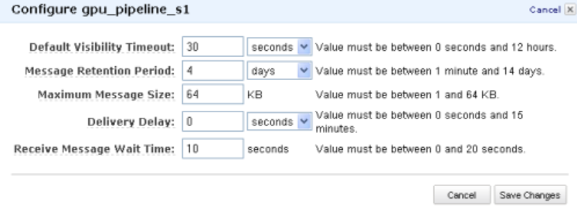
Long and short polling
Attributes for the Long polling:
Wait for some time before results
Results more accurate
If no messages, get empty messages

Slide 14
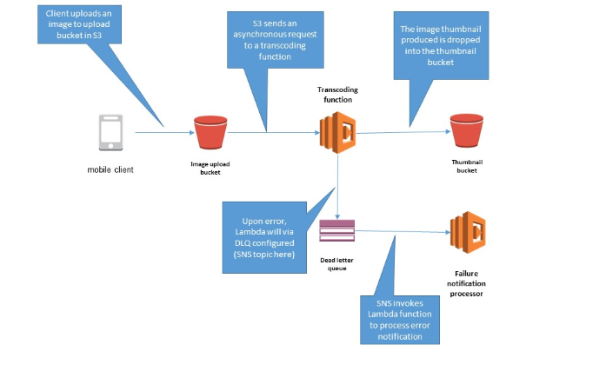
Dead letter queues
We need to debug issues:
Send messages but not process
Handle situations where the data sent to the consumer is more than the maxRequest count
https://aws.amazon.com/blogs/compute/robust-serverless-application-design-with-aws-lambda-dlq/

Slide 15
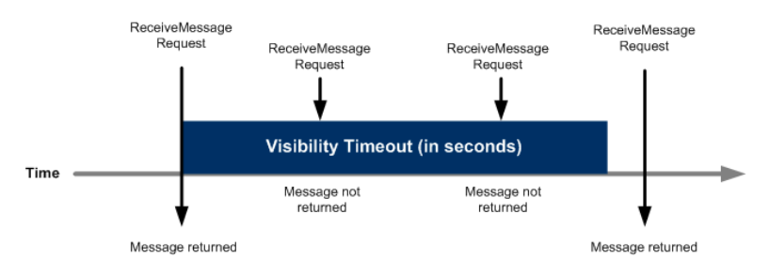
Visibility timeout
Visibility timeout:
Time to process by consumer and deleted before the message is reusable for other consumers.
https://aws.amazon.com/blogs/compute/robust-serverless-application-design-with-aws-lambda-dlq/

Slide 16
Inflight messages
An Amazon SQS message has three basic states:
Sent to a queue by a producer.
Received from the queue by a consumer.
Deleted from the queue.
The different positions of the messages:
Stored when sent from to the queue and not processed
Inflight when received but not deleted

Slide 17
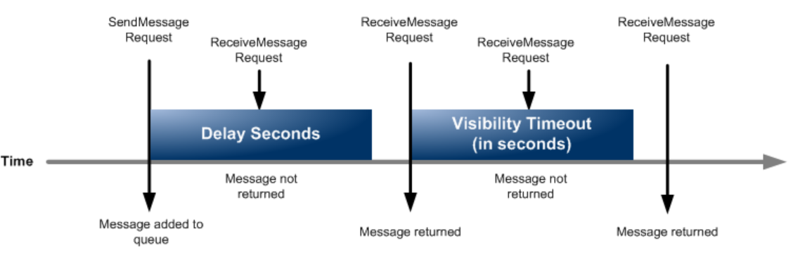
Delay queues
Delay queues involves, sending message in a delayed state before sending to a queue

